Slide 1
10. Etching
Notes:
6/2

Slide 2
Wet etching
resist formation → develop → etching.
Wet etching: wafer is immersed in a solution that reacts with the exposed film to form soluable by-products.
Drawback:
  Isotropy etching
  poor process control
  particle contamination
  Chemical waste
Pro
  Highly selective
  Does not damage substrate

Slide 3
Wet etching
Consists of 3 processes
  Movement of etchant species to wafer surface
  Chemical reaction with exposed film that produces soluble by-products
  reaction products away from wafer surface
Wet etch solution is often agitated to assist movement of etchant to surface and removal of etch product
Some wet etch use a acid spray to supply fresh etchant
Small geometry features may etch more slowly, due to difficulty in removing etch products → loading effect

Slide 4
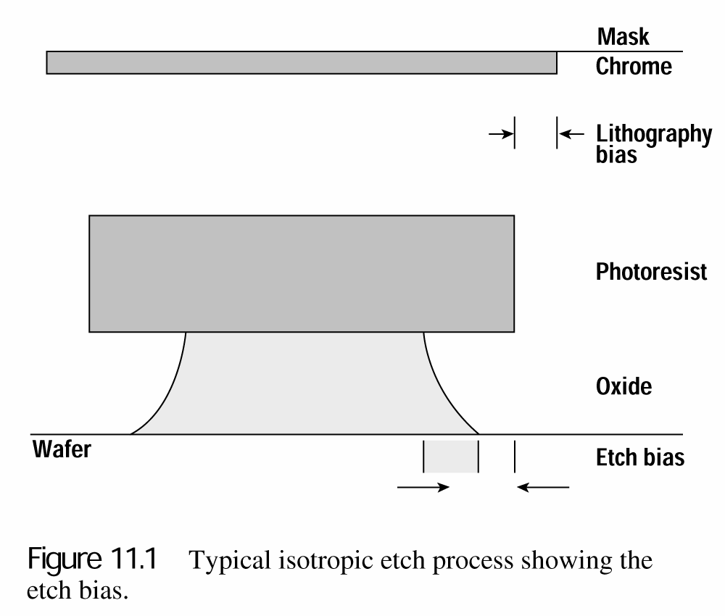
Figure of Merit
Uniformity
  Etch rate variation over a wafer
  Etch rate variation from wafer to wafer
Selectivity
Undercut
Etch rate anisotropy A = 1 – R_{L}/R_{V}
R_{L}: lateral etch rate
R_{V}: vertical etch rate
A=1 perfectly anisotropic
A=0 perfectly isotropic

Slide 5
HF Wet etching (SiO₂)
Wet etching of SiO₂ in dilute solutions of hydrofluoric acid:
- etchants of 6:1, 10:1, 20:1 (vol % of water:HF)
- isotropic process
HF solutions are extremely selective of oxide over silicon
- SiO₂+6HF → H₂+SiF₆+2H₂O
As this reaction consumes HF, reaction rate decrease with time
To avoid that, the use of HF with a buffering agent such as ammonium fluoride (NH₄F) can maintains a constant concentration of HF through dissolution reaction. NH₃ (ammonia) is a gas. Buffering also controls etchant PH, which minimizes resist attack.
- NH₄F $↔$ NH₃+HF

Slide 6
Silicon nitride etching
Wet etching (Si, Si₃N₄, Al)
Si wet etching
Use a strong oxidant to oxidize Si and HF to etch etch oxide
Etchant: HF, HNO₃ in water
Si + HNO₃ + 6HF → H₂SiF₆ + HNO₂ + H₂ + H₂O
H₃PO₄ at 140-200℃
If nitride layer is exposed to a high-temp oxidizing ambient, a dip in BHF should be done before nitride wet etching to strip surface oxide that have grown on top of nitride
Metal wet etching
Al etchant: (by volume) 20% acetic acid, 77% phosphoric acid, 3% nitric acid
Impurities in Al, such as Si, Cu, are difficult to remove in standard Al wet etch

Slide 7
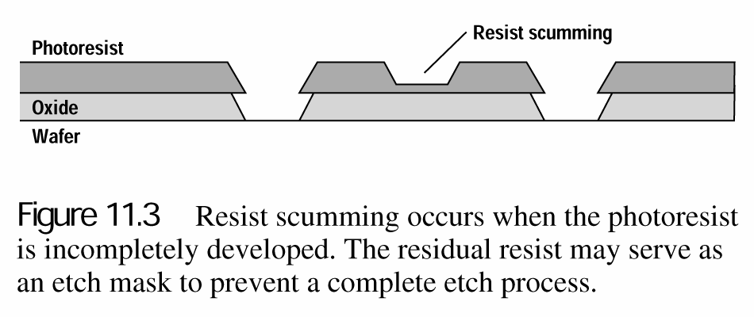
Wet etching issue
Resist scumming
- resist is not removed in develop process
- serve as an etch mask to prevent a complete etch process

Slide 8
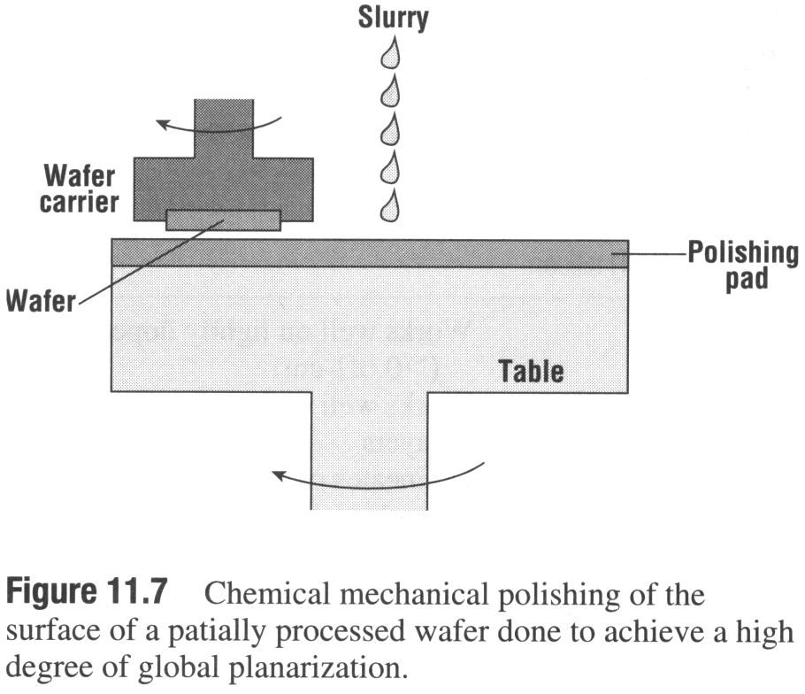
Chemical Mechanical Polishing (CMP)
Wafer is mechanically abraded in alkaline slurry containing colloidal silica (a suspension of abrasive SiO₂ particles) and an etching agent such as dilute HF.
KOH and NH₄OH are common matrix solutions for the suspension.
pH 10 is maintained to keep silica particles negatively charged to avoid formation of a gel
pH buffering agent can be used to ensure stability of the process

Slide 9
CMP
Gross mechanical damage is prevented by the fact that SiO₂ particles being used in the slurry are not harder than the film that is being polished
Typical removal rates of SiO₂ are several thousand angstroms per min
Increase pad pressure increases removal rate, causing decrease in step height, residual oxide damage, or metal contamination

Slide 10
CMP
Metal planarization: copper, tungsten
Acidic (pH<3) slurries are used. Theses slurries cause colloidal suspensions and so agitation must be used to maintain uniformity
Alumina is the commonly used abrasive for tungsten CMP because it is closer in hardness to tungsten than most other abrasives
Cu is polished in aqueous solution containing particles several hundred nanometers in diameter
Typical slurries include ammonium hydroxide, nitric acid, hydrogen peroxide
Notes:
산성도 수소이온농도 로그의 역수

Slide 11
Basic regimes of plasma etching
Advantages of plasma etching
  Easier to start and stop
  Less sensitive to changes of wafer temperature
  High anisotroy
  Fewer particles than liquid media
  Less chemical waste than wet etching

Slide 12
Plasma etch process
A feed gas be broken down into chemically reactive species by plasma.
These species diffuse to wafer surface. They move until reacting with the exposed film.
Reaction products are desorbed, diffused away from wafer, and then transported by gas stream out of etch chamber

Slide 13
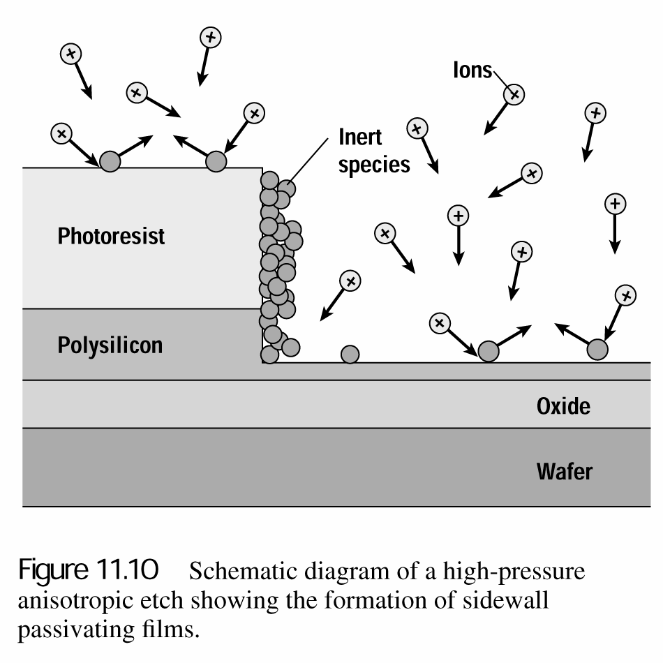
Plasma etch process
Anisotropic etch can be achieved due to the formation of sidewall passivation film
Ion velocity, which follows electric field, is vertical
Little ion bombardment on sidewall → accumulation of fluorocarbon with non-volatile species → polymerization reducing etching rate
The polymerization passivation on sidewall → preventing lateral etching → leading to excellent vertical etching

Slide 14
Ion milling
Pure ion milling/ion beam etching: no chemical reactions, since it uses noble gases such as argon.
A strictly mechanical process
Advantages:
  Directionality: ions are accelerated by a strong electric field, chamber pressure is low that atomic collision is not likely. Anisotropic etching is possible for any material since it is chemistry independent
  Applicability: it can be used to pattern a wide variety of materials including compounds and alloys
Ions are positively charged, a voltage will build up on the surface unless wafer and film being etched are conductive
To avoid charging effect, electron flood gun is used

Slide 15
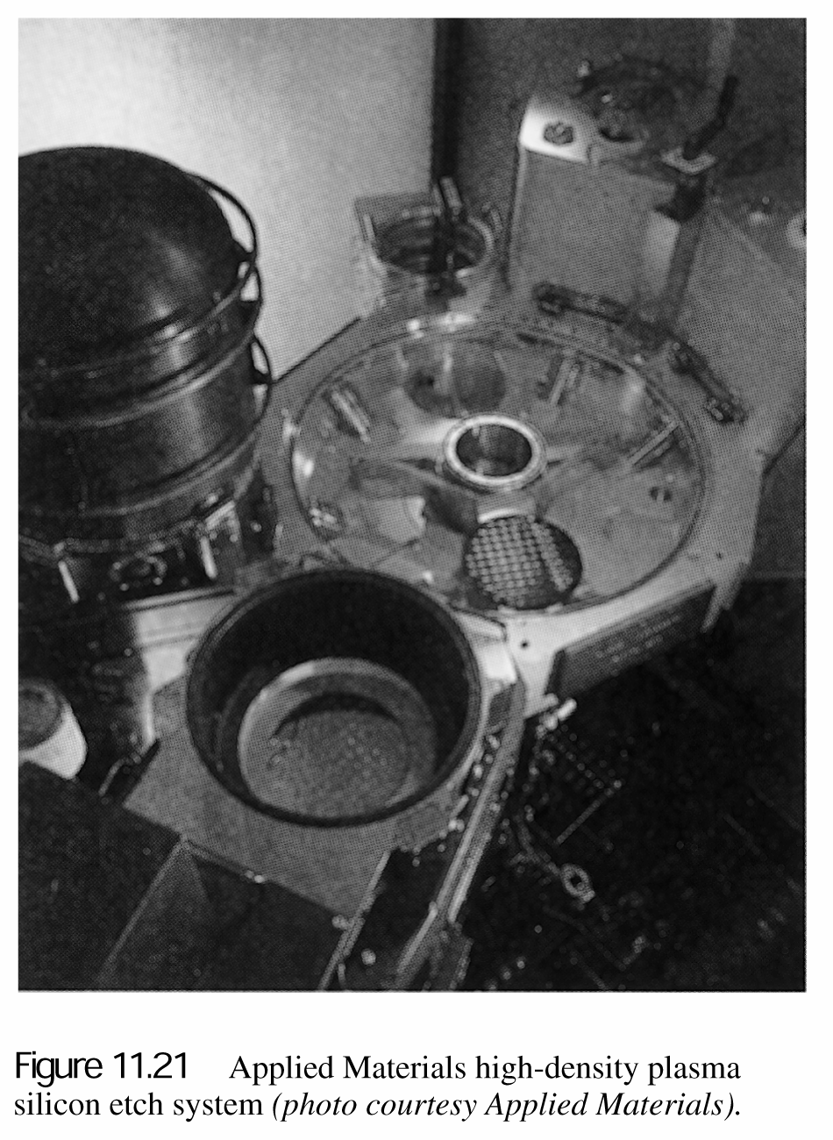
High-Density Plasma (HDP) etching
High-density sources can be generated by crossed magnetic and electric fields to increase distance the free electrons in plasma travel, increasing the rate of dissociation and ionization
High density of ions and radicals is used to increase etch rate
A HDP system: inductively coupled reactor use RF current through coils to produce an oscillating magnetic field that creates an electric field
This induced magnetic field alters path of electrons in plasmas, increase plasma density

Slide 16
11. Doping
(Diffusion)

Slide 17
Prologue
semiconductor devices rely on the ability to fabricate well controlled, locally doped regions of the wafer.
chemical doping must be introduced into some sections of the wafer
it contributes to the creation of the desired carrier
Number density of Si is 5x10²² atoms/cm³ while typical impurity concentration for active device regions is 10¹⁷ atoms/cm³ for few parts per million.
Motion of impurity atoms in wafer occurs primarily by diffusion, the net movement of a material that occurs near a concentration gradient as a result of random thermal motion.

Slide 18
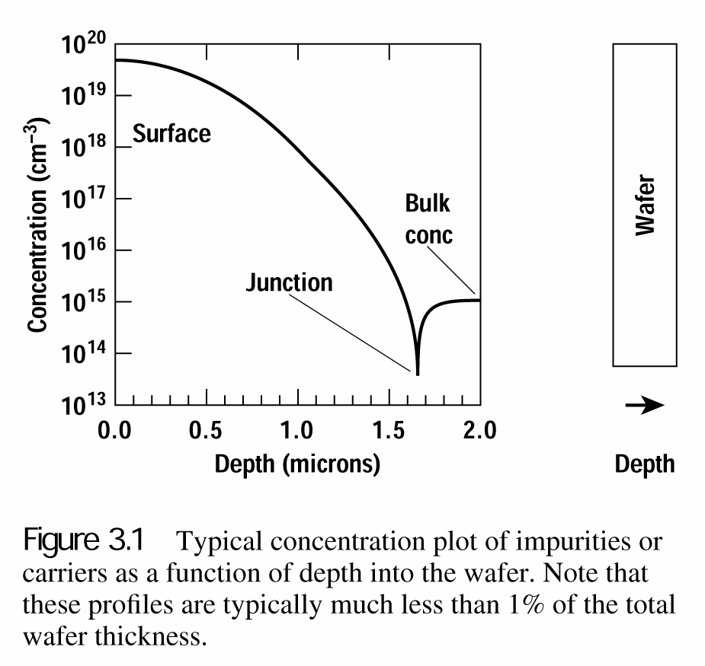
Fick’s first law
Fick’s first law
_{J = −D} ∂C( x, t)
∂x
C: atoms/cm³
D: coefficient of diffusion (cm²/sec)
J: net flux (atoms/cm²〮sec)
- showing diffusion process
- “$−$” sign means decreasing concentration
- not showing flow of impurity density
- introduce Fick’s 2nd law
Notes:
F(flux): 단위 시간, 단위 면적당 확산하는 불순물의 총량 (g/cm²〮s)
D(diffusion coefficient): 확산계수, 확산속도를 의미 (cm²/s)
C(concentration): 단위 부피당 도펀트 농도 (g/cm³)
X: 확산거리 (cm)
확산의 driving force: 농도구배(농도가 높은 영역에서 낮은 영역으로 이동)가 있는 경우에만 확산 발생

Slide 19
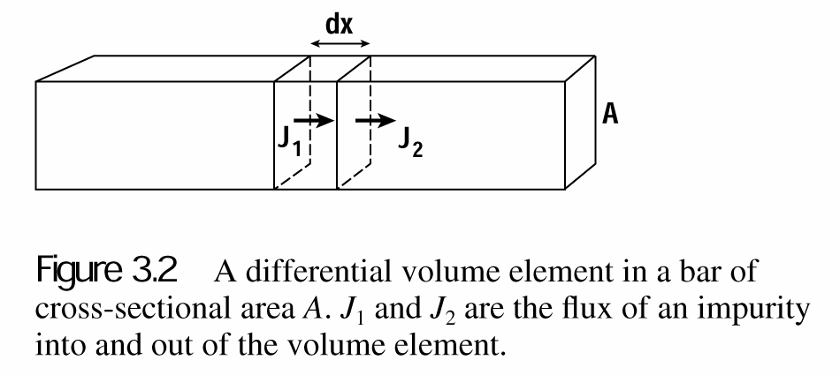
Fick’s second law
Adx ^{∂C} = A(J − J ) = − A( J − J ) = − Adx ^{∂J} = − Adx ∂ (−D ^{∂C} )
∂t ¹ ² ² ¹ ∂x ∂x ∂x
If D is independent of position
2
∂C _{= D} ∂ C
∂t
∂x²
특정 영역에서 시간에 따른 농도변화는 농도구배의 변화량에 비례
Notes:
Flow rate = Volume/t=Ad/t

Slide 20
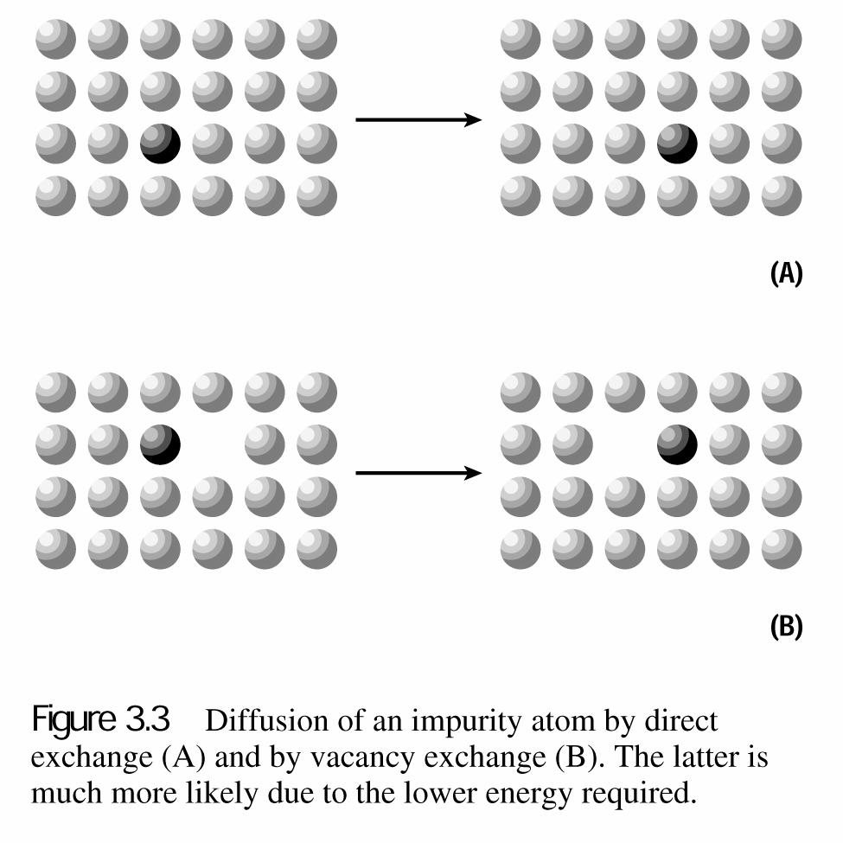
Atomistic models of diffusion
Interstitial impurities (O, Au, Fe, Cu, Ni, Zn, Mg) diffuse rapidly, buy they do not directly contribute to hoping.
Substitutional impurities (P, B, As, Al, Ga, Sb, Ge)
  Direct change: 6 bonds be broken for host atom and impurity to exchange positions
  Vacancy exchange: 3 bonds be broken. Dominant diffusion mechanism for substitutional impurities.
Notes:
6/9 일대

Slide 21
Diffusion systems
Most doping is now done by ion implantation rather than predeposition diffusion.
When very heavily doped layers are required, diffusion tubes are used to introduce the desired dopants.
Two methods used to heavily dope layers in furnace tube
  Liquid source doping
  Solid source doping

Slide 22
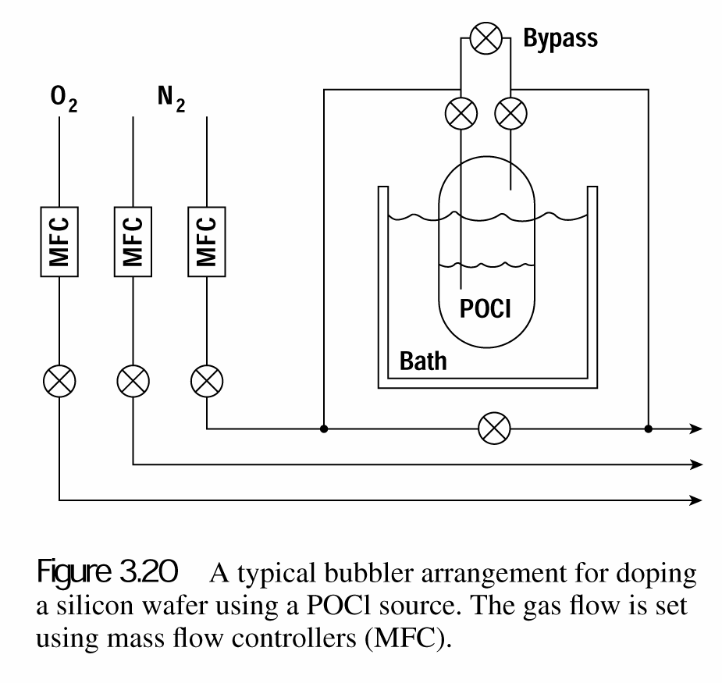
Liquid source doping
Container of the liquid is immersed in a constant temp bath to produce a known vapor pressure of the dopant above the liquid surface
An inert gas is injected into the bubbler
Partial pressure of dopant in furnace is controlled by bath temp, gas pressure above liquid
Usually an O₂ source is supplied to react with the dopant gas

Slide 23
Liquid source
Most common boron source is BBr3. reactions occur in furnace
– Dissociation
2BBr₃ → 2B + 3Br₂
– Oxidation
4B + 3O₂ → 3B₂O₃
Oxide is transported to wafer surface where it oxidizes the surface to release free boron
2B₂O₃ + 3Si → 4B + 3SiO₂
Liquid source phosphorus doping is done using a bubbler of POCl₃, oxide that forms is P₂O₅. this oxide dissociates at the wafer surface releasing P and forming SiO₂.

Slide 24
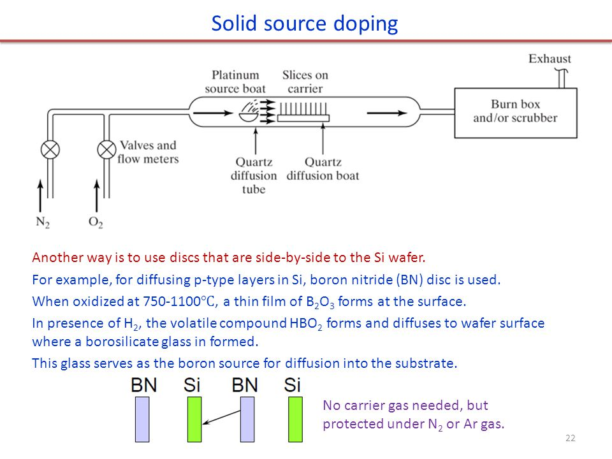
Solid source
Source discs are about the same size as wafer and are loaded in alternate slots in furnace boats
For diffusing p-type layers in Si, BN disc is used
When oxidized at 750-1100℃, a thin film of B₂O₃ forms at the surface.
in presence of H₂, the volatile compound HBO₂ forms and diffuses to wafer surface where a borosilicate glass (70–80 wt% SiO₂, 7–13 wt% of B₂O₃) is formed.
This glass serves as the boron source for diffusion into the substrate.

Slide 25
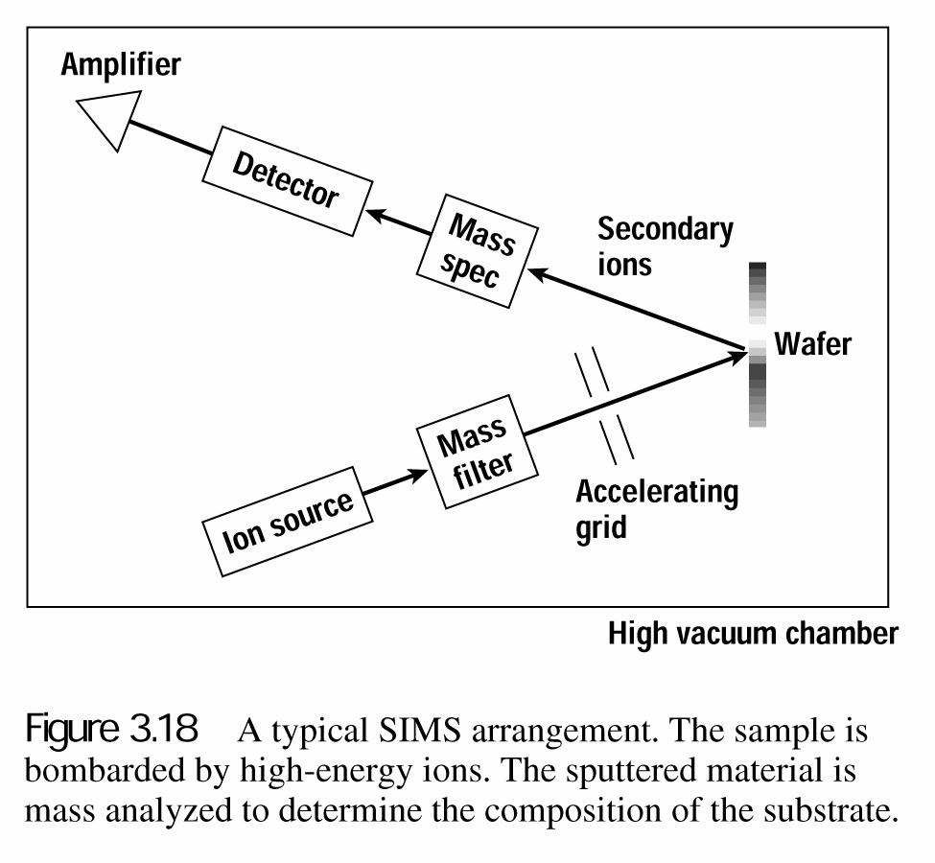
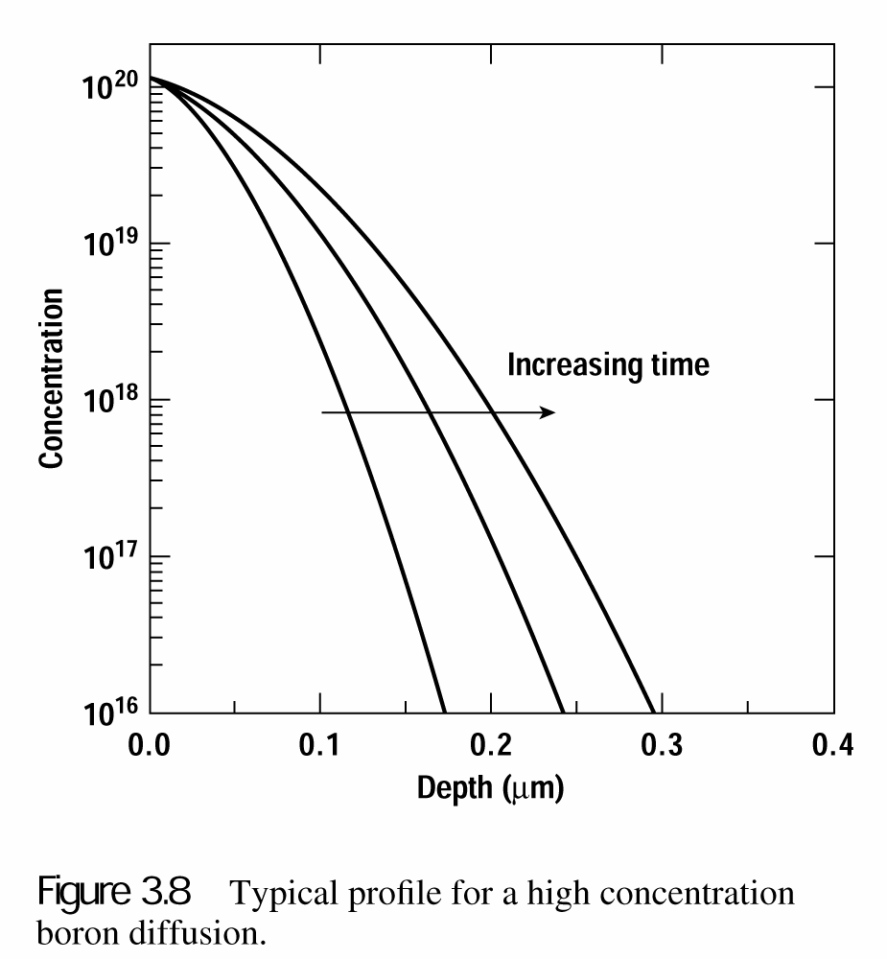
Qualitative analysis of dopant
SIMS (secondary ion mass spectroscopy)
high-vacuum (10⁻⁹ torr)
1 ~ 5 keV energy ion (O₂ or Cs)
ppm & ppb level concentration detection is possible as function of depth

